Slide 1

CIS121 MavPass Exam Review
3/2/2022

Slide 2

Ice breaker
Introduce your name and major
What book do you own but have never read?

Slide 3
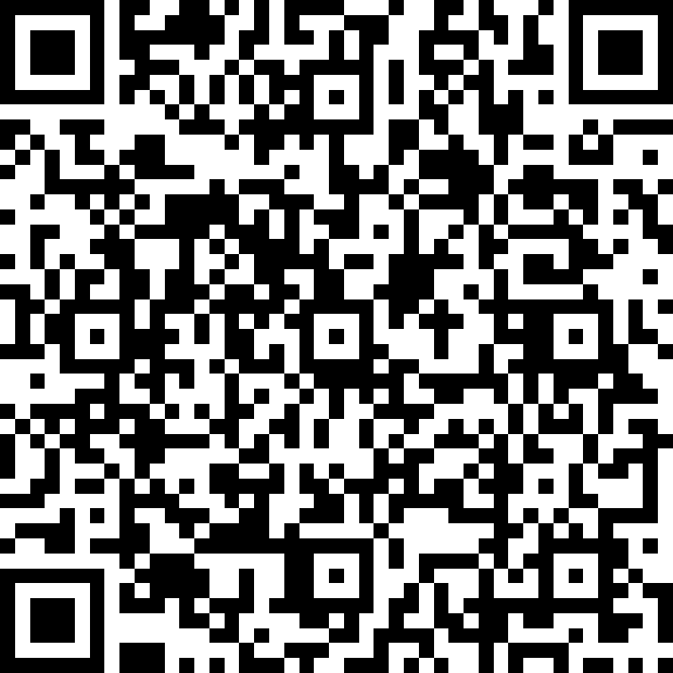
Attendance CIS121 MavPASS Session
https://forms.office.com/pages/responsepage.aspx?id=xscRULQKq0ae9PrnSpIaf8Jeg9NwiYFJtEEipPejT79UNkFaVjJCV1YxWDVWV0NJRTVMOUFQUTlPUSQlQCN0PWcu

Slide 4
Key points
You'll be in breakout rooms where you'll discuss about the concepts underneath and give examples.
0
Arithmetic operators (math operators)
How to print variables , integers, float and string
How to promote a user to input integers and string?
What are Booleans
Why and how to use selection statements( If statement )
What is while loop
What is for loop
What are functions
How to create functions
What are List
What are Tuples
What are Recursive Functions

Slide 5
Group one
What do we know about Arithmetic operators (math operators)
How to print variables , integers, float and string
How to promote a user to input integers and string?
What are List?
What are Tuples ?
What are Dictionaries?

Slide 6
Group Two
AND
OR
NOT
Why and how to use selection statements( If statement )
What are Boolean
What is while loop
What is for loop

Slide 7
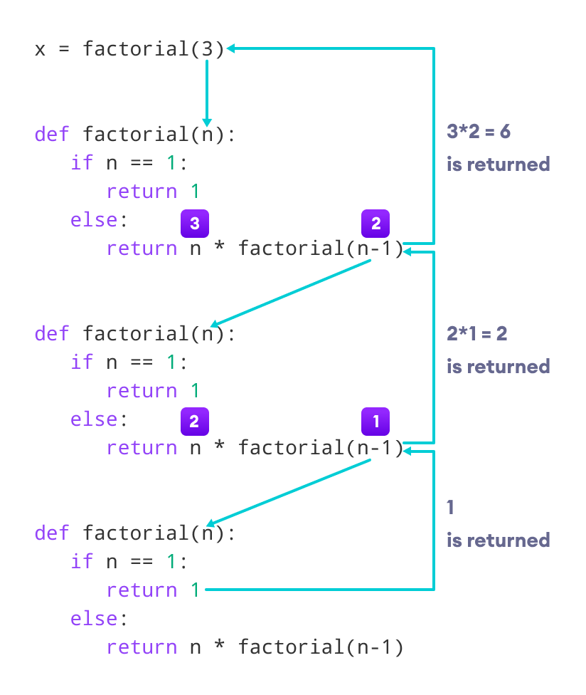
Group Three
What are functions
How to create functions
What are Recursive Functions

Slide 8
Access List Elements There are various ways in which we can access the elements of a list.
my_list = ['p', 'r', 'o', 'b', 'e'] # first item print(my_list[0]) # p # third item print(my_list[2]) # o # fifth item print(my_list[4]) # e # Nested List n_list = ["Happy", [2, 0, 1, 5]] # Nested indexing print(n_list[0][1]) print(n_list[1][3]) # Error! Only integer can be used for indexing print(my_list[4.0])

Slide 9
What are return statement and calling functions?

Slide 10
A return statement ends the execution of a function, and returns control to the calling function. Execution resumes in the calling function at the point immediately following the call. A return statement can return a value to the calling function.

Slide 11
Practice Problem
Print from 20 to 1 jumping by 2.
Print each element School= [ book, pen, laptop, apple]
Print only multiples of 3 from 1 to 60.
For 10 in range:
Print("I")

Slide 12
Practice Problem
Write and test a program that computes the area of a circle. The program should request a number representing a radius as input from the user.

Slide 13
practice problem
Write and test a program that accepts the lengths of three sides of a triangle as inputs. The program output should indicate whether the triangle is an equilateral triangle.

Slide 14
practice problem
Write a recursive function that takes a number and returns the sum of all the numbers from zero to that number. Using recursive function
I will call this function ‘cumulative’. If I provide 10 as an input it should return the sum of all the numbers from zero to 10. That is 55.

Slide 15
practice problem
Write a code that print multiplication table for each numbers from 1 to 10
And try to print it by creating a new text file
Example ->
1,2,3,4,5,6,7,8,9,10. 2,4,6,8,10,12,14,16,18,20. 3,6,9,12,15,18,21,24,27,30. 4,8,12,16,20,24,28,32,36,40. 5,10,15,20,25,30,35,40,45,50. 6,12,18,24,30,36,42,48,54,60. 7,14,21,28,35,42,49,56,63,70. 8,16,24,32,40,48,56,64,72,80. ....

